Slide 1
Accounting for Managers (PART ONE)
Compiled By: Dr Maha Ramadan Associate Professor of Accounting and Auditing Eslsca University- Egypt Mob. 01001047652
Email: maha.ramdan@eslsca.edu.eg

Slide 2
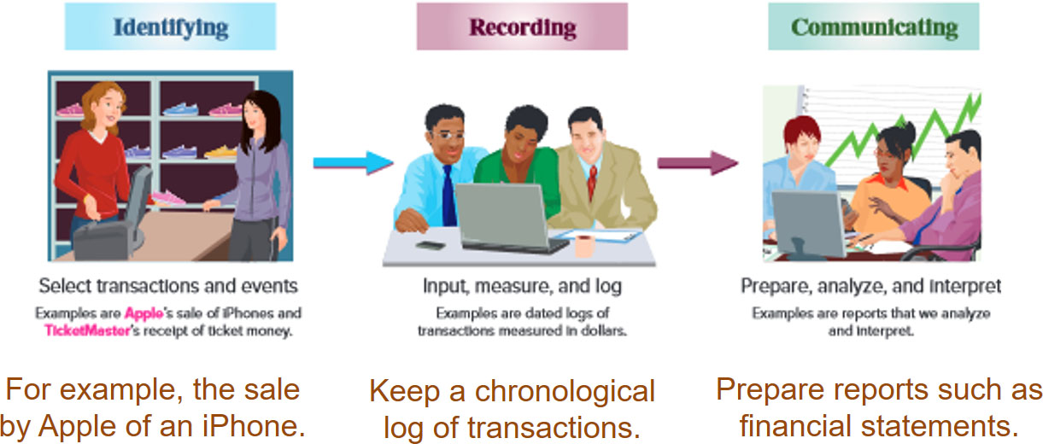
Importance of Accounting
Accounting is an information and measurement system that identifies, records, and communicates an organization’s business activities.
Access the text alternative for slide images.
2
Learning Objective C1: Explain the purpose and importance of accounting.
Notes:
Accounting is an information and measurement system that identifies, records, and communicates an organization’s business activities.
Identifying business activities requires that we select relevant transactions and events.
Recording business activities requires that we keep a chronological log of transactions and events measured in dollars.
Communicating business activities includes preparing accounting reports such as financial statements, which we analyze and interpret.
Recordkeeping, or bookkeeping, includes the recording of transactions and events and is just one part of accounting.

Slide 3
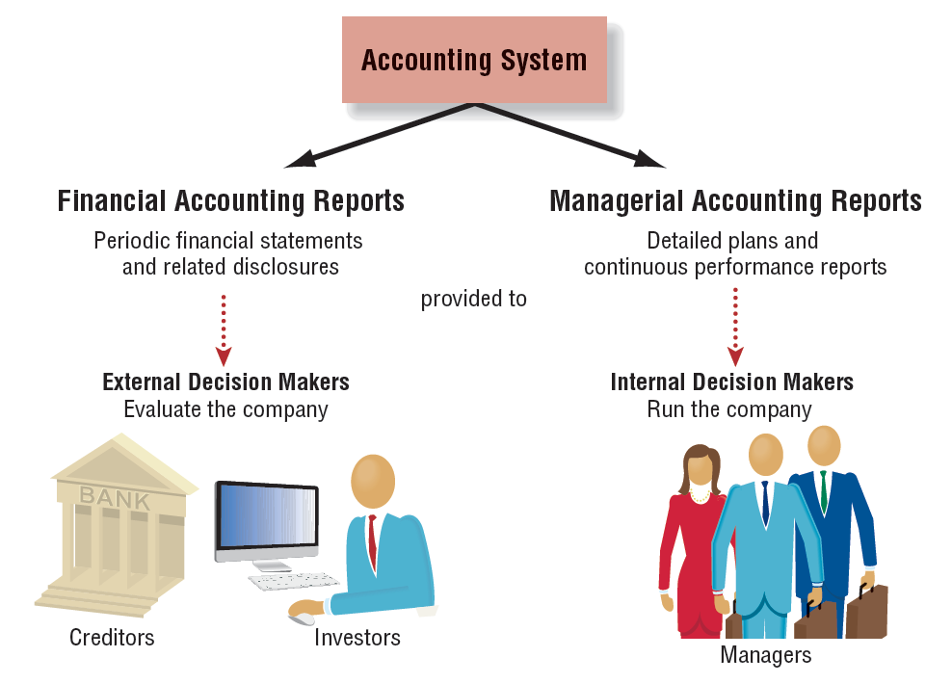
The Accounting System
Notes:
The accounting system collects and processes financial information about an organization and reports that information to decision makers. The accounting system provides financial accounting reports which include periodic financial statements and related disclosures to external decision makers. These decision-makers include investors, creditors, suppliers, customers, union representatives, and all other interested parties. The accounting system also provides managerial accounting reports including detailed plans and continuous performance reports. These reports are used by internal decision makers throughout the organization to make decisions about pricing, production, quality, and numerous other day-to-day activities.

Slide 4
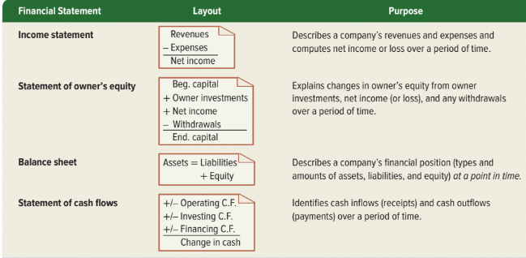
Financial Statements

Slide 5
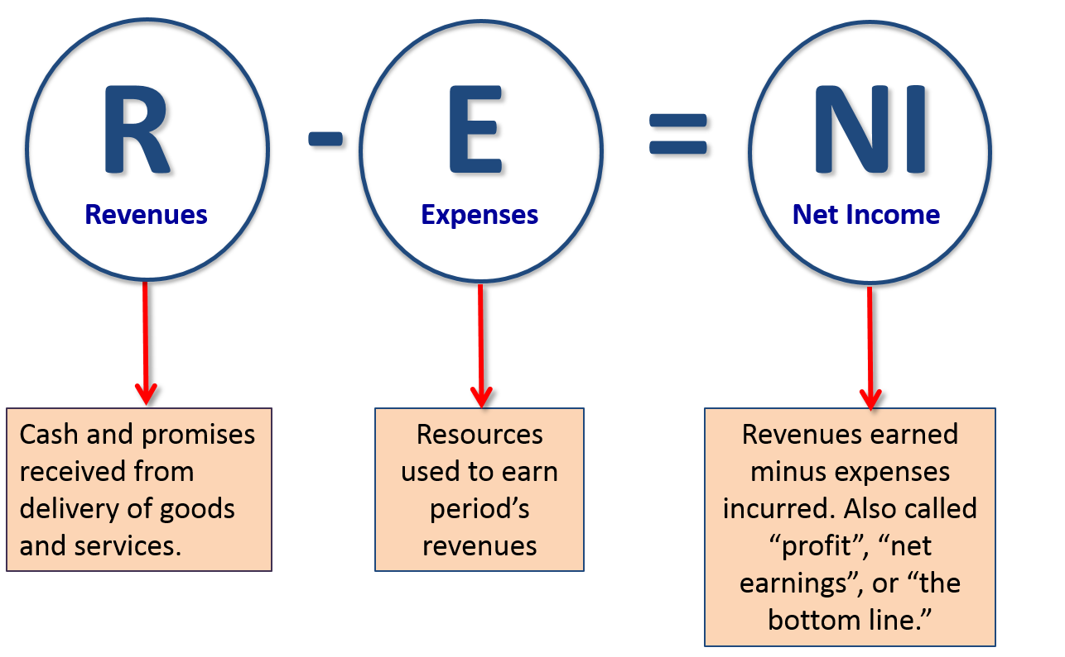
The Income Statement Equation
If total expenses exceed total revenues, a net loss is reported.
Access the text alternative for these images

Slide 6
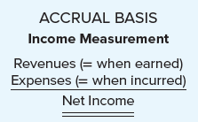
How Are Operating Activities Recognized and Measured?
Accrual Basis Accounting
Accrual basis accounting is required by accounting standards and used to report to external decision makers.
The accounting principles that determine when revenues and expenses are recorded are the revenue recognition principle and the expense recognition principle (also called the matching principle).
Revenues are recognized when goods and services are provided to customers (they are earned)
Expenses are recognized in the same period as the revenues to which they relate (resources are used or debts are incurred to generate revenues), regardless of when cash is received or paid.
Notes:
Generally accepted accounting principles require accrual basis accounting for financial reporting.
In accrual basis accounting, revenues are recognized when goods and services are provided to customers (they are earned), and expenses are recognized in the same period as the revenues to which they relate (resources are used or debts are incurred to generate revenues), regardless of when cash is received or paid. The two basic accounting principles that determine when revenues and expenses are recorded under accrual basis accounting are the revenue recognition principle and the expense recognition principle (also called the matching principle).

Slide 7
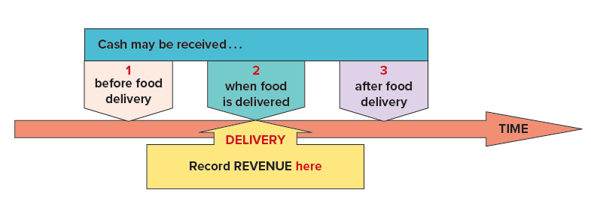
Recording Revenues versus Cash Receipts
Cash may be received at any of these times:
Before the goods or services are delivered.
In the same period as the goods or services are delivered.
After the goods or services are delivered.
Revenue is always recorded when the goods or services are delivered, not when the cash is received from customers.
Notes:
The critical point for revenue recognition is when goods or services are delivered, not when cash is received from customers. Cash may be received before, after, or at the time of delivery.
1 Cash is received before the goods or services are delivered. Companies sells gift cards to customers for cash in exchange for the promise to provide future goods or services. Because the company has not delivered the goods or services at that point, it records no revenue. Instead, it creates a liability account, Unearned Revenue (also called Deferred Revenue), representing the amount owed to the customers. Later, when customers redeem their gift cards and the goods are delivered, the company earns and records the revenue while reducing the liability account because it has satisfied its promise to deliver.
2 Cash is received in the same period as the goods or services are delivered. Goods are delivered in exchange for cash, earning revenue in the process.
3 Cash is received after the goods or services are delivered. When a business sells goods or services on account (creating Accounts Receivable due from customers), the revenue is earned when the goods or services are delivered, not when cash is received at a later date. Assume goods are ordered by customers and the company bills them at the end of the month, rather than when they receive the goods. When delivered, the company records Sales Revenue and the asset Accounts Receivable, representing the customer’s promise to pay in the future. When the customer pays its monthly bill, the company will increase its Cash account and decrease the asset Accounts Receivable.

Slide 8
Expense Recognition Principle
The expense recognition principle (also called the matching principle) requires that costs incurred to generate revenues be recognized in the same period—a matching of costs with benefits.
The costs of generating revenue include expenses incurred such as:
Salaries and wages to employees who worked during the period.
Utilities for the electricity used during the period.
Supplies used during the period.
Facilities rented during the period.
Equipment used during the period.
Expenses are recorded as incurred, regardless of when cash is paid.
Notes:
Step 1. Identify the contract (written, verbal, or implied agreement) between the company and customer.
Step 2. Identify the seller’s performance obligations (promised goods and services).
Step 3. Determine the transaction price (the amount the seller expects to be entitled to receive from the customer).
Step 4. Allocate the transaction price to the performance obligations.
Step 5. Recognize revenue when each performance obligation is satisfied (or over time if a service is provided over time).
For most contracts discussed in this text, the revenue recognition steps are easy to apply. The critical point for revenue recognition under the five-step model is when goods or services are delivered, not when cash is received from customers. Cash may be received before, after, or at the time of delivery.

Slide 9
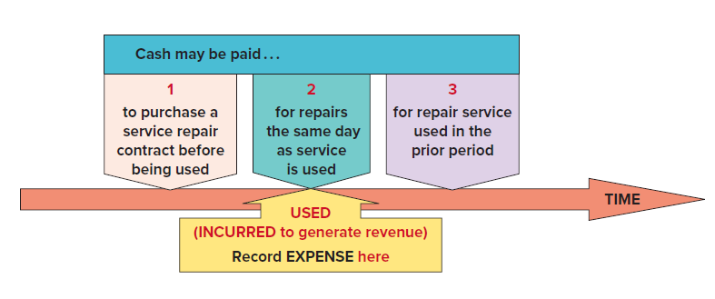
Recording Expenses versus Cash Payments
Cash may be paid at any of these times:
Before the expense is incurred to generate revenue.
In the same period as the expense is incurred to generate revenue.
After the cost is incurred to generate revenue.
Expense is always recorded when the cost is incurred, not when the cash is paid.
Notes:
The expense matching principle requires that costs incurred to generate revenues be recognized in the same period—a matching of costs with benefits. For example, when Chipotle’s restaurants provide food service to customers, revenue is earned. The costs of generating the revenue are recognized as expenses in the same period.
Expenses are recognized as incurred, regardless of when cash is paid. Cash may be paid (1) before. (2) during, or (3) after an expense is incurred.

Slide 10
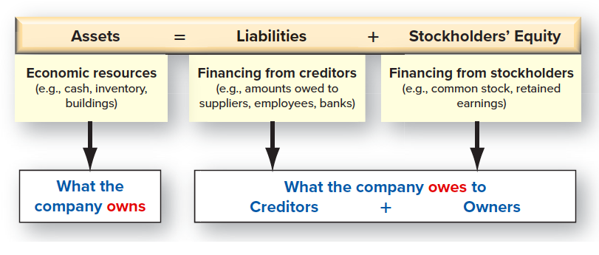
The Balance Sheet Equation (Accounting Equation)
The basic accounting equation refers to a company’s financial position: the economic resources that the company owns and the sources of financing for those resources.
Notes:
Assets = liabilities + equity
Inventory 10M +3M-6K = Bank loan 10M +2M Capital 7M +3M=10M
Building 7M Accounts Payable 5M Revenues +1K +10K
Equipment 3M Expenses -2K-6K
Delivery van 1M Profit 3K
Cash 1M+2M+1K-2K-1K Dividends -1K
A/Receivable 10K Retained earnings 2K
Total 75M
Assets are economic resources owned by the company that have some future economic benefit.
Liabilities are the amount of financing provided by the creditors (debts, obligations).
Stockholders’ equity indicates the amount of financing provided by owners of the business and reinvested earnings of the company since inception that were not distributed as dividends to the shareholders.
A corporation is a business that is incorporated under the laws of a particular state. The owners are called stockholders or shareholders.

Slide 11
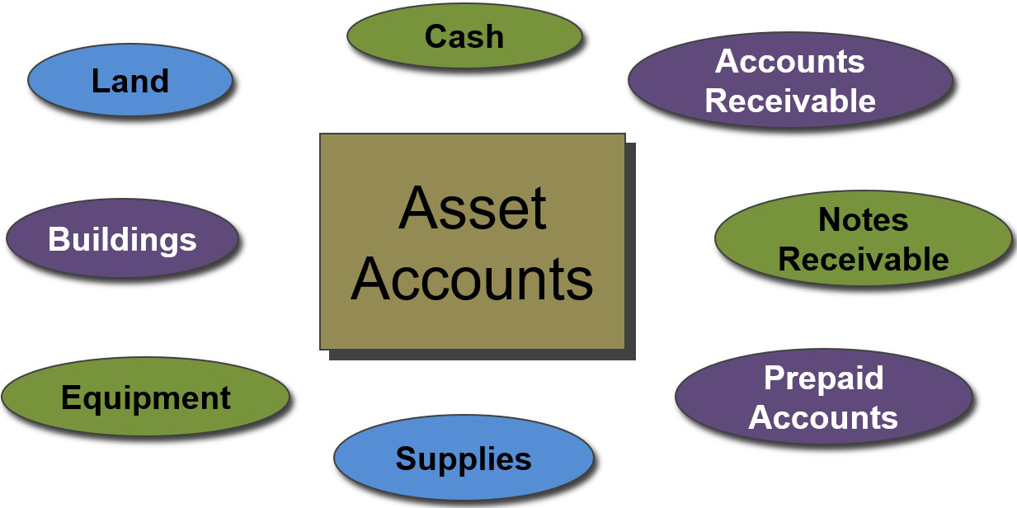
Asset Accounts
Learning Objective C2: Describe an account and its use in recording transactions.
Notes:
Here is a listing of common asset accounts we are likely to find in all businesses.
Cash reflects a company’s cash balances. It includes money and any funds that a bank accepts for deposit (coins, checks, money orders, and checking account balances).
Accounts Receivable are held by a seller and are promises of payment from customers to sellers. These transactions are often called credit sales or sales on account (or on credit). Accounts receivable are increased by credit sales on account.
Notes Receivable is similar to Accounts Receivable except it’s interest bearing where Accounts Receivable does not.
Prepaid accounts, also called prepaid expenses, are assets that represent prepayments of future expenses (expenses expected to be incurred in one or more future accounting periods). When the expenses are later incurred, the amounts in prepaid accounts are transferred to expense accounts. Examples include prepaid insurance, prepaid rent, and prepaid services.

Slide 12
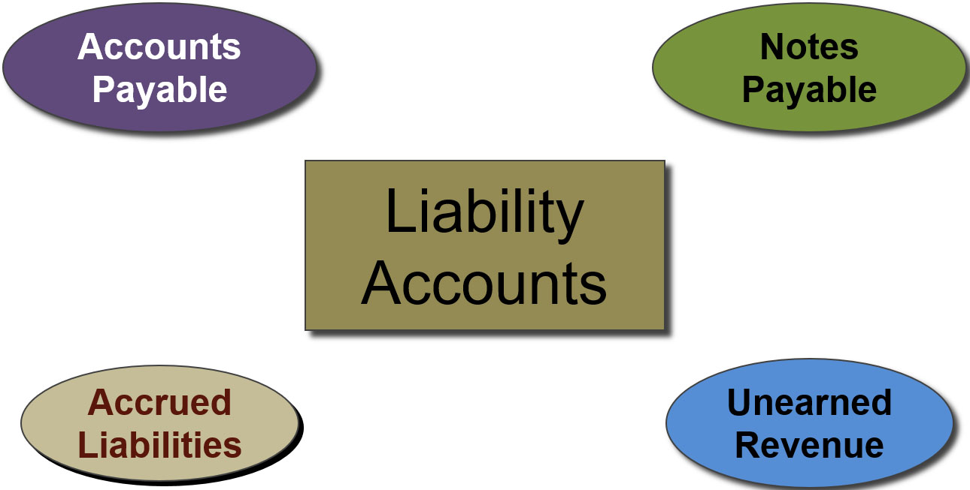
Liability Accounts
Learning Objective C2: Describe an account and its use in recording transactions.
Notes:
Liabilities are claims by creditors against assets. Creditors are individuals and organizations that have rights to receive payments from a company.
This is a listing of common liability accounts we are likely to see in the general ledger.
Accounts payable are promises to pay later, which usually come from purchases of merchandise for resale.
Note payable is a written promissory note to pay a future amount (often interest bearing notes).
Accrued liabilities are amounts owed that are not yet paid.
Unearned revenue is a liability that is settled in the future when a company delivers its product or services. If you subscribe to a magazine, you generally pay a one-year subscription in advance. For the publishing company, cash is received but nothing has been done to earn the revenue. As the magazine is delivered to you, the publishing company recognizes a portion of the money received as revenue. At the end of the year, all the revenue will be earned and the liability no longer exists.

Slide 13
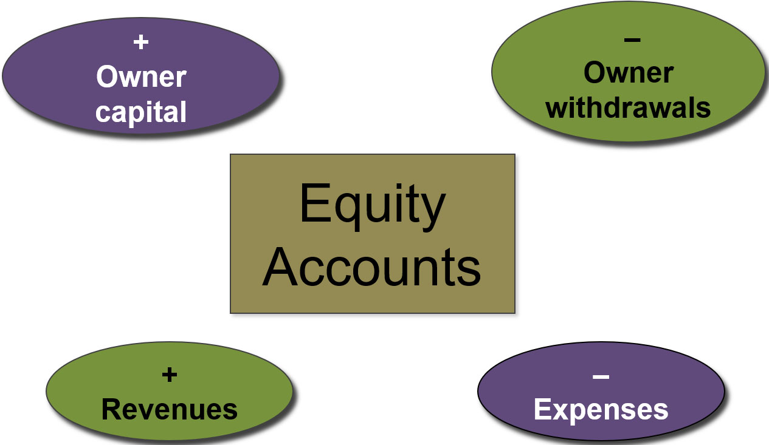
Equity Accounts
Learning Objective C2: Describe an account and its use in recording transactions.
Notes:
The owner’s claim on a company’s assets is called equity or stockholders’ equity, or shareholders’ equity. Equity is the owner’s residual interest in the assets of a business after deducting liabilities.
Equity is impacted by four types of accounts:
Owner capital
Owner withdrawals
Revenues
Expenses
Owner Investments increase both assets and equity. The increase to equity is recorded in an account titled Owner capital. Owner investments are not revenues of the business.
Owner withdrawals decrease both assets and equity. The decrease to equity is recorded in an account titled Owner withdrawal. Owner withdrawals are not expenses of the business.

Slide 14
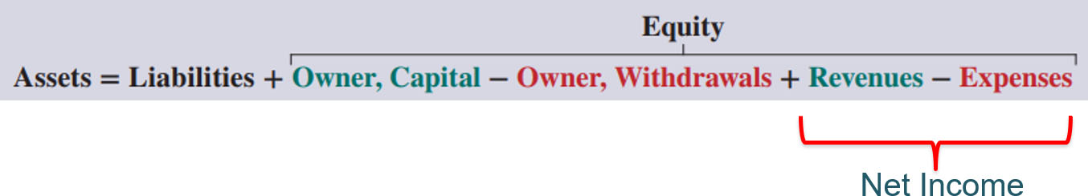
Business Transaction and Accounting
The Accounting Equation:
Assets = Liabilities + Equity
Expanded Accounting Equation:
Access the text alternative for slide images.
Learning Objective A1: Define and interpret the accounting equation and each of its components.
Notes:
Accounting reflects two basic aspects of a company: what it owns and what it owes.
Assets are resources a company owns or controls. These resources are expected to yield future benefits. Examples are cash, supplies, equipment, land, and Web servers for an online services company. The term receivable refers to an asset that promises a future inflow of resources. A company that provides a service or product on credit is said to have an account receivable from that customer.
Liabilities are creditors’ claims on assets. These claims reflect company obligations to provide assets, products, or services to others. The term payable refers to a liability that promises a future outflow of resources. Examples are wages payable to workers, accounts payable to suppliers, and notes payable to banks.
Equity is the owner’s claim on assets, and is equal to assets minus liabilities. This is the reason equity is also called net assets or residual equity. Equity is increased by owner investments, and from revenues. It is decreased by owner withdrawals and expenses. Equity (also called owner’s equity or capital) refers to the claims of its owner(s). Together, liabilities and equity are the source of funds to acquire assets.
Equity has four parts: owner capital; owner withdrawals, revenues and expenses.
Owner, Capital reflects inflows of cash and other net assets from owner contributions which increase equity.
Owner, Withdrawals are outflows of cash and other assets to owners, which reduce equity.
Revenues increase equity from sales of products and services to customers.
Expenses decrease equity from costs of providing products and services to customers.

Slide 15
Learning Objective
Analyze business transactions using the accounting equation.

Slide 16
Transaction 1: Investment by Owner
Chas Taylor invests $30,000 cash to start a business named Fast Foward.
The accounts involved are:
Cash (asset) ↑
C. Taylor, Capital (equity) ↑
Learning Objective P1: Analyze business transactions using the accounting equation.
Notes:
Let’s look at the identification and recording of business transactions. We can begin by analyzing a transaction where Chas Taylor forms a consulting business, named. Taylor personally invests thirty thousand dollars cash in the new company and deposits the cash in a bank account opened under the name of FastForward. First, we have to identify the assets, liability or equity accounts involved in this transaction. We can see that the cash account will increase by thirty thousand dollars and the C. Taylor, Capital account will also increase by thirty thousand dollars. Let’s see how the books of the company will appear after we record this transaction.

Slide 17
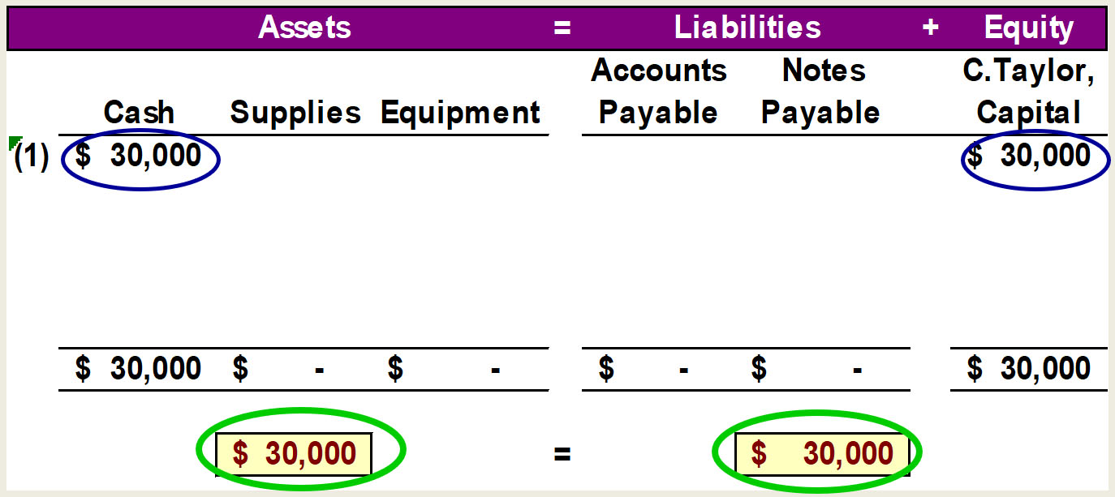
Accounting Equation 1
Chas Taylor invests $30,000 cash to start the business, Fast Foward.
Access the text alternative for slide images
Learning Objective P1: Analyze business transactions using the accounting equation.
Notes:
Here we show the increase in the asset account, cash, and the increase in the equity account, C. Taylor, Capital, by thirty thousand dollars. Our basic accounting equation is in balance. Assets have a total balance of thirty thousand dollars and liabilities plus equity have a total balance of thirty thousand dollars. Let’ move on to another transaction.

Slide 18
Transaction 2: Purchase Supplies for Cash
Company purchased supplies by paying $2,500 cash.
The accounts involved are:
(1) Cash (asset) ↓
(2) Supplies (asset) ↑
Learning Objective P1: Analyze business transactions using the accounting equation.
Notes:
In this transaction, the company purchases general office supplies by paying two thousand, five hundred dollars cash. The asset account, cash, will decrease by the two thousand, five hundred dollars cash paid. The asset account, supplies, will increase by two thousand, five hundred dollars, the cost of the supplies. In this transaction we are giving up one asset, cash, and receiving another asset, supplies. Let’s look at our books after this transaction is recorded.

Slide 19
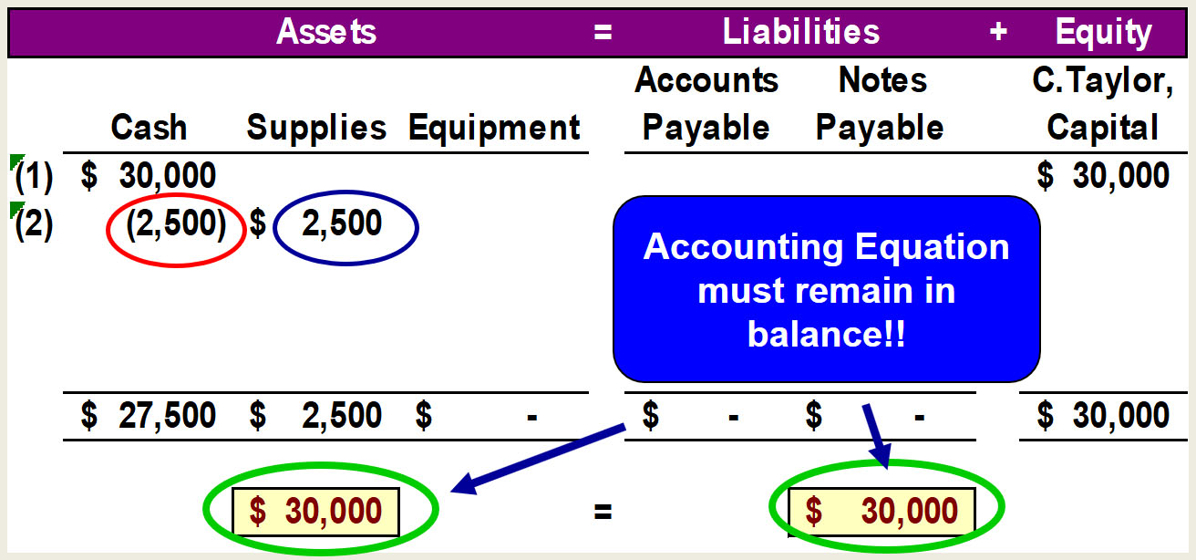
Accounting Equation 2
Company purchased supplies by paying $2,500 cash.
Access the text alternative for slide images
Learning Objective P1: Analyze business transactions using the accounting equation.
Notes:
We can see the decrease in cash and the increase in supplies. The total assets are still equal to thirty thousand dollars but are divided between cash and supplies. There is no change on the liabilities plus equity section of our books.

Slide 20
Transaction 3: Purchase Equipment for Cash
Purchased equipment for $26,000 cash.
The accounts involved are:
(1) Cash (asset) ↓
(2) Equipment (asset) ↑
Learning Objective P1: Analyze business transactions using the accounting equation.
Notes:
This transaction is similar to the last one we recorded. Here we purchase equipment by paying twenty six thousand dollars cash. The asset account, cash, will decrease by twenty six thousand dollars. The asset account, equipment, will increase by twenty six thousand dollars. Once again, we are exchanging one asset for another. Can you predict what our books will look like after recording this transaction?

Slide 21
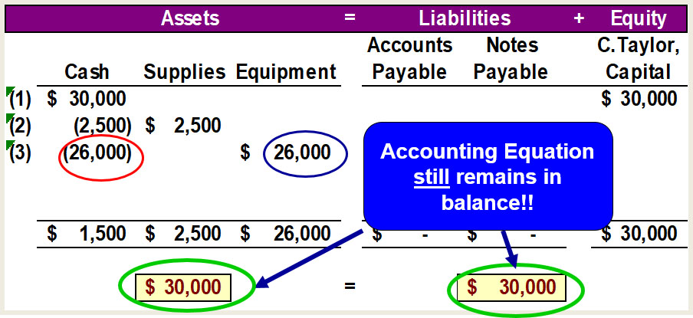
Accounting Equation 3
Purchased equipment for $26,000 cash.
Access the text alternative for slide images
Learning Objective P1: Analyze business transactions using the accounting equation.
Notes:
Cash is reduced by twenty six thousand dollars and equipment is increased by twenty six thousand dollars. The balance in our cash account is now one thousand five hundred dollars. We have a current balance in supplies of two thousand five hundred dollars, and equipment of twenty six thousand dollars. The three asset accounts total thirty thousand dollars. Once again, there has been no change in the liabilities plus equity side of the equation.

Slide 22
Transaction 4: Purchase Supplies on Credit
Purchased supplies of $7,100 on credit.
The accounts involved are:
(1) Supplies (asset) ↑
(2) Accounts Payable (liability) ↑
Learning Objective P1: Analyze business transactions using the accounting equation.
Notes:
In this transaction, the company purchases supplies seventy one hundred dollars on credit. We do not pay cash, but agree to pay off the account at some point in the future. The asset account, supplies increases by seventy one hundred dollars and the liability account, accounts payable, increases by seventy one hundred dollars as well. Let’s see what our books look like now.

Slide 23
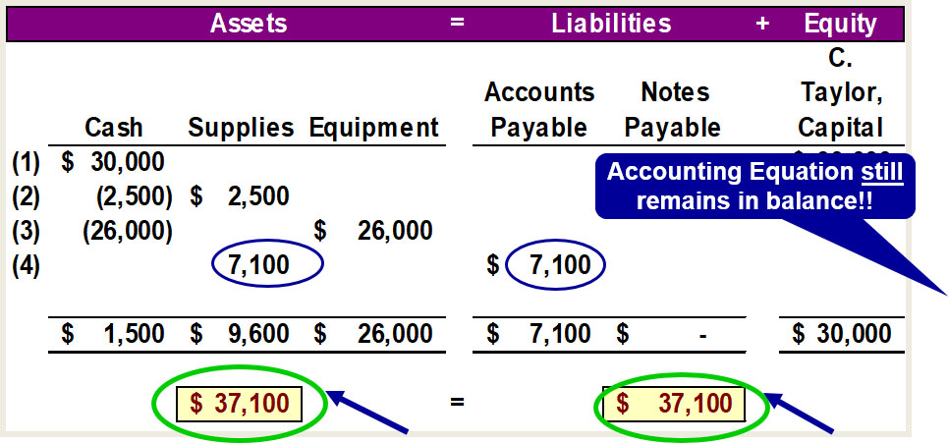
Accounting Equation 4
Purchased supplies of $7,100 on credit.
Access the text alternative for slide images
Learning Objective P1: Analyze business transactions using the accounting equation.
Notes:
You can see the balance in the cash, supplies and equipment accounts. The total on the asset side of the equation is thirty seven thousand, one hundred dollars. We acquired the assets without paying cash. If you use a credit card to purchase gas for your car, you receive an asset, gas, and incur an account payable to the credit card company. The balance in the liabilities accounts is now seventy one hundred dollars, and the C. Taylor, Capital account balance is still thirty thousand dollars.

Slide 24

Transaction Analysis: Revenues, Expenses and Withdrawals
Now, let’s look at transactions involving revenues, expenses and withdrawals.
Learning Objective P1: Analyze business transactions using the accounting equation.
Notes:
To this point, we have not looked at transactions involving revenues, expenses, and withdrawals. In the next few slides we will address these accounts.

Slide 25
Transaction 5: Provide Services for Cash
Provided consulting services to a customer and received $4,200 cash right away.
The accounts involved are:
(1) Cash (asset) ↑
(2) Revenues (equity) ↑
Learning Objective P1: Analyze business transactions using the accounting equation.
Notes:
The company rendered consulting services to a customer receiving forty two hundred dollars cash in full payment. The asset account, cash, will increase by forty two hundred dollars. The equity account, revenues, will also increase by the same amount. Let’s look at our expanded book balances.

Slide 26
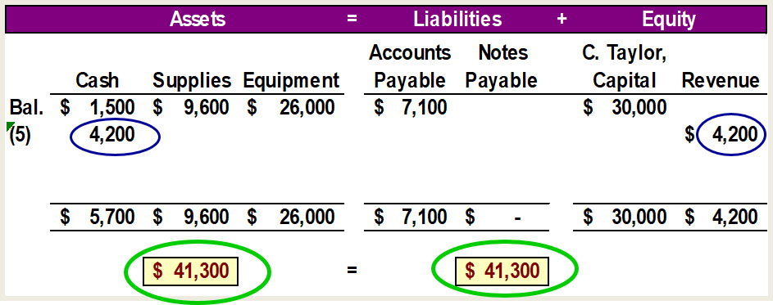
Accounting Equation 5
Provided consulting services to a customer and received $4,200 cash right away.
Access the text alternative for slide images
Learning Objective P1: Analyze business transactions using the accounting equation.
Notes:
You see that our cash account increases by forty two hundred dollars, to a current balance of five thousand seven hundred dollars. Total assets amount to forty one thousand, three hundred dollars. The revenue account also increased by forty two hundred dollars. Recall that from our expanded accounting equation that revenues increase equity and expenses decrease equity. The total of our liabilities plus equity is now forty one thousand, three hundred dollars.

Slide 27
Transaction 6 and 7: Payment of Expenses in Cash
Paid rent of $1,000 and salaries of $700 to employees.
The accounts involved are:
(1) Cash (asset) ↓
(2) Rent expense ↑ (equity) ↓
(3) Salaries expense ↑ (equity) ↓
Remember that the balance in the Expense accounts actually unincrease. enBut, total Equity decreases, because expenses begireduce endequity.
Learning Objective P1: Analyze business transactions using the accounting equation.
Notes:
The company paid cash rent of $1,000 and cash salaries of $700 to employees. The asset account, cash, decreases by one thousand seven hundred dollars. The equity account, rent expense increases by $1,000 and salaries expense increases by $700. Remember, an increase in an expense account will decrease total equity. Do you think you can get this transaction recorded properly in our books?

Slide 28
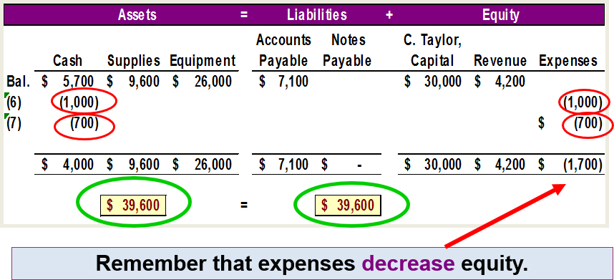
Accounting Equation 6 and 7
Paid rent of $1,000 and salaries of $700 to employees.
Access the text alternative for slide images
Learning Objective P1: Analyze business transactions using the accounting equation.
Notes:
How did you do? You got the decrease in the cash account, but did you remember to show the increase in expenses as a decrease in total equity. Our expanded equation is getting to look more and more complicated. Don’t worry, practice will help you fully understand the recording of these and similar transactions. Our books are still in balance.

Slide 29
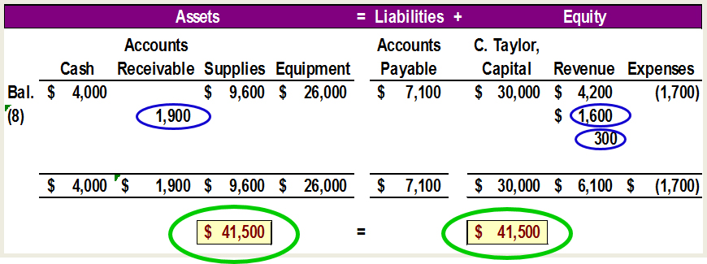
Accounting Equation 8
Provided consulting services of $1,600 and rents facilities for $300 to a customer for credit.
Access the text alternative for slide images
Learning Objective P1: Analyze business transactions using the accounting equation.
Notes:
Our expanded equation is getting to look more and more complicated. Don’t worry, practice will help you fully understand the recording of these and similar transactions. Our books are still in balance.

Slide 30
Transaction 9: Receipt of Cash from Accounts Receivable
Client in transaction 8 pays $1,900 for consulting services.
The accounts involved are:
(1) Cash (asset) ↑
(2) Accounts receivable (asset) ↓
Learning Objective P1: Analyze business transactions using the accounting equation.
Notes:
The client in transaction 8 pays $1,900 10 days after it is billed for consulting services.

Slide 31
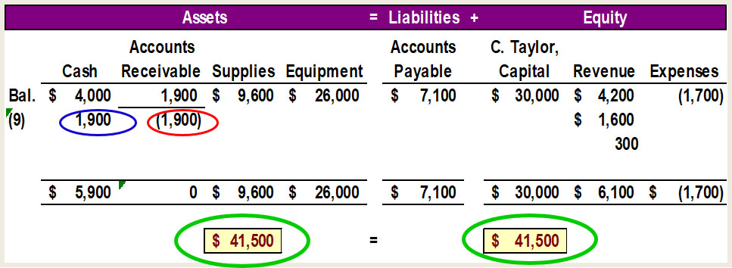
Accounting Equation 9
Client in transaction 8 pays $1,900 for consulting services.
Access the text alternative for slide images
Learning Objective P1: Analyze business transactions using the accounting equation.
Notes:
The client in transaction 8 pays $1,900 10 days after it is billed for consulting services. The total amount of assets remains the same, and liabilities and equity remain the same as well.

Slide 32
Transaction 10: Payment of Accounts Payable
Fast Forward pays $900 as partial payment for supplies purchased in transaction 4.
The accounts involved are:
(1) Cash (asset) ↓
(2) Accounts payable (liability) ↓
Learning Objective P1: Analyze business transactions using the accounting equation.
Notes:
FastForward pays $900 as partial payment for its earlier purchase of supplies purchased in transaction 4 leaving $6,200 balance unpaid.

Slide 33
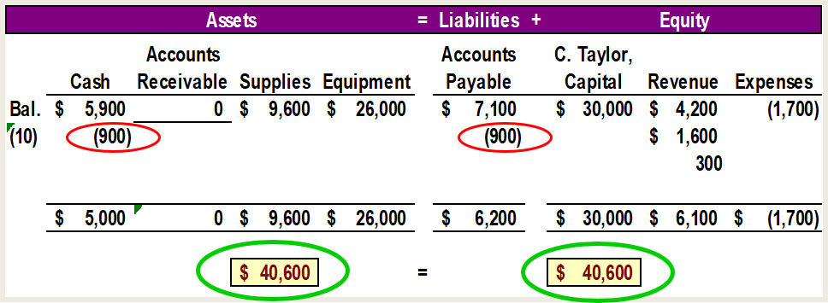
Accounting Equation 10
FastForward pays $900 as partial payment for supplies purchased in transaction 4.
Access the text alternative for slide images
Learning Objective P1: Analyze business transactions using the accounting equation.
Notes:
FastForward pays $900 as partial payment for its earlier purchase of supplies purchased in transaction 4 leaving $6,200 balance unpaid in its Accounts payable account.

Slide 34
Transaction 11: Withdrawal of Cash by Owner
Owner withdraws $200 cash for personal use.
The accounts involved are:
(1) Cash (asset) ↓
(2) C. Taylor, Withdrawals ↑ (equity) ↓
Remember that the Withdrawals account actually increases (just like our Expense accounts).
But, total Equity decreases because withdrawals cause equity to go down!!
Learning Objective P1: Analyze business transactions using the accounting equation.
Notes:
The owner of FastForward withdraws $200 cash for personal use. The company’s cash account decreased by $200. The equity account, C. Taylor, Withdrawals, increased by $200. Once again, refer back to the expanded accounting equation and you will see that owner withdrawals decrease total equity.

Slide 35
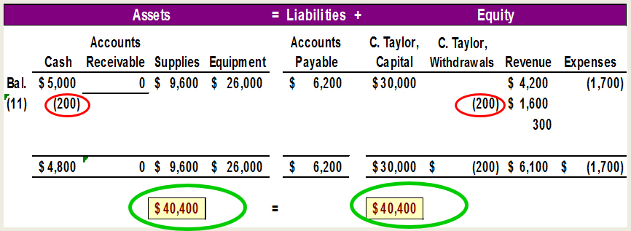
Accounting Equation 11
Owner withdraws $200 cash for personal use.
Access the text alternative for slide images
Learning Objective P1: Analyze business transactions using the accounting equation.
Notes:
The company’s cash account decreased by $200. The equity account, C. Taylor, Withdrawals, increased by $200.

Slide 36
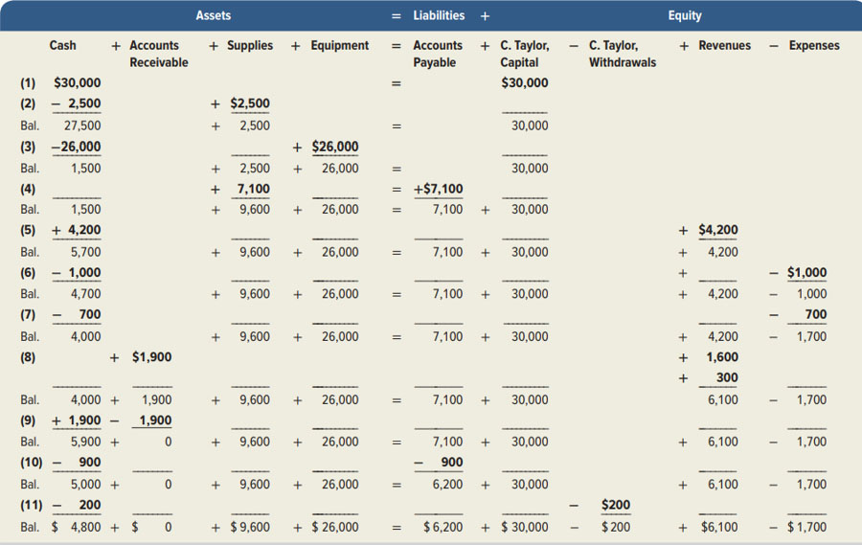
Summary of Transactions
Exhibit 1.9
Access the text alternative for slide images
Learning Objective P1: Analyze business transactions using the accounting equation.
Notes:
Exhibit 1.9 shows the effects of all 11 transactions using the accounting equation.

Slide 37
Financial Statements
The four financial statements and their purposes are:
Income statement — describes a company’s revenues and expenses and computes net income or loss over a period of time.
Statement of owner’s equity— explains changes in equity from owner investments and net income (or loss) and from any withdrawals over a period of time.
Balance sheet — describes a company’s financial position (types and amounts of assets, liabilities, and equity) at a point in time.
Statement of cash flows — identifies cash inflows (receipts) and cash outflows (payments) over a period of time.
Learning Objective P2: Identify and prepare basic financial statements and explain how they interrelate.
Notes:
This section introduces us to how financial statements are prepared from the analysis of business transactions. The four financial statements and their purposes are:
Income statement — describes a company’s revenues and expenses and computes net income or loss over a period of time.
Statement of owner’s equity— explains changes in equity from owner investments and net income (or loss) and from any owner withdrawals over a period of time.
Balance sheet — describes a company’s financial position (types and amounts of assets, liabilities, and equity) at a point in time.
Statement of cash flows — identifies cash inflows (receipts) and cash outflows (payments) over a period of time.

Slide 38
Balance Sheet
Elements of the Balance Sheet
Assets Cash Short-Term Investment Accounts Receivable Notes Receivable Inventory (to be sold) Supplies Prepaid Expenses Long-Term Investments Equipment Buildings Land Intangibles
Liabilities Accounts Payable Accrued Expenses Notes Payable Taxes Payable Unearned Revenue Bonds Payable
Stockholders’ Equity Common Stock Retained Earnings
Notes:
The purpose of the balance sheet is to report the financial position (assets, liabilities and stockholders’ equity) of an entity at a particular point in time. Here is a sample list of balance sheet accounts grouped into categories. These categories, also known as elements, are assets, liabilities, and stockholders’ equity.
Assets are economic resources owned by the company. The exact list of assets depends on the individual company, but this is a representative list. All assets are expected to provide future benefits to the company.
Liabilities are the company’s debts or obligations.
Stockholders’ equity generally consists of two parts. First, Common Stock indicates the amount of financing provided by owners of the business. Next, Retained Earnings is the amount of income that has been earned by the company that has been reinvested in the business rather than being distributed as dividends to shareholders.
In this course we will discuss all of these accounts in detail.

Slide 39

Statement of Stockholders’ equity
Elements of the Statement of Stockholders’ Equity
Common Stock
Retained Earnings
Beginning Retained Earnings
+Net Income
-Dividends
Ending Retained Earnings
Notes:
The statement of stockholders’ equity reports the changes in each of the company’s stockholders’ equity accounts, including the change in the retained earnings balance caused by net income and dividends during the reporting period. Beginning Retained Earnings plus Net Income minus Dividends equals Ending Retained Earnings.

Slide 40
Statement of cash flows
Elements of the Statement of Cash Flows
Cash Flows from Operating Activities
Cash Flows from Investing Activities
Cash Flows from Financing Activities
+
Note that each of the three cash flow sources can be positive (net cash inflow) or negative (net cash outflow).
/
-
Notes:
The statement of cash flows reports inflows and outflows of cash for a stated period of time classified into three categories: operating, investing, and financing activities.
Cash flows from operating activities are cash flows that are directly related to earning
income.
Cash flows from investing activities include those related to the acquisition or sale of the company’s plant and equipment and investments.
Cash flows from financing activities are directly related to the financing of the enterprise itself.

Slide 41
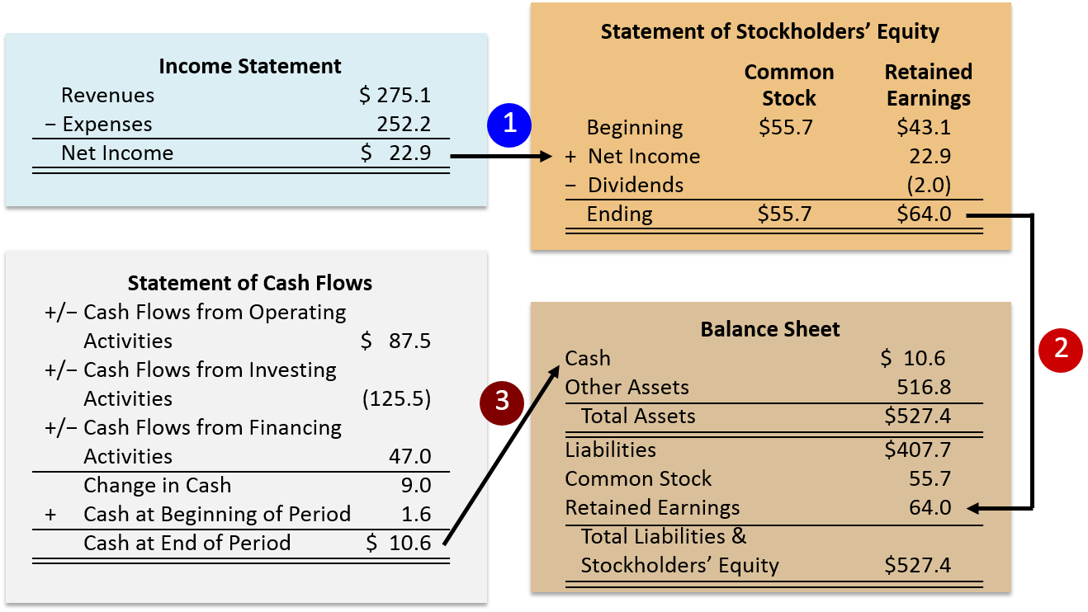
Exhibit 1.6 Relationships Among Le-Nature’s Statements
Access the text alternative for these images

